Slide 1
Lake Dalecarlia Enhancement Committee June 2025 update
Lake Enhancement Committee (Paul Panczuk & Sue Shields) met 6-9-2025 with County Commissioner Tippy, County Surveyor Bill Emerson, Highway Dept Duane Alverson, and various county staff.
Clark Street Southeast tributary and culvert project, joint project Lake County Highway Dept. and POA (CARDNO report Site #2)– Engineering substantially complete. Plans require land acquisition; county is beginning this process. Estimated cost of project now $700,000+
Foss Ditch redirection north of 153rd (CARDNO report Site #6)– American Structurepoint completed preliminary engineering. County met with landowner, he is considering minor modifications for aesthetics. Landowner agreed to perform earth work when development occurs, however, this has stalled due to Cedar Lake building moratorium. County will procure an estimate to perform the work as designed by American Structurepoint. (County drainage board approved $40,000 engineering/permitting February 2024)
Western Tributaries (CARDNO report sites #8,9,10 under Colfax to Lake)
Wildwood Tributary- CARDNO site #9,10 sourced from West Dale Estates and farm, located in county Wildwood easement between Colfax and lake. County will investigate West Dale Estates basin function and flow rate. County investigating erosion control using armor and/or pipe between Colfax and Lakeview.
Island Drive tributary – CARDNO site #8 Colfax to lake, 260 feet in length. Private property and POA outlot. High sediment runoff, erosion, overland flow during large rainfall. Contacted 4 contractors, received three bids approximately $50K, $35-40K, $21K to repair and armor tributary per CARDNO recommendations. Recommend accepting lowest bid submitted by Hubinger Landscape @ $21K and utilizing existing restoration fund (earmarked for sediment reduction). Note: No county easement in this area. Landowner has provided verbal approval to allow earth work within 20’ area adjacent Island Drive. Recommend securing written agreement.

Slide 2
#8
Island Drive tributary
stabilization proposal
Jume 2025
County Drainage Board exploring project
to reroute Foss ditch reducing
overland flow and incoming sediment
#15
Contacted developer,
communicated recommendations
for shoreline stabilization.
#9 & #10
Wildwood tributary
exploring options for
flow control &
sediment reduction.
(USDA & County)
#2
County Highway/POA
Clark Road culvert
replacement
& bank stabilization

Slide 3
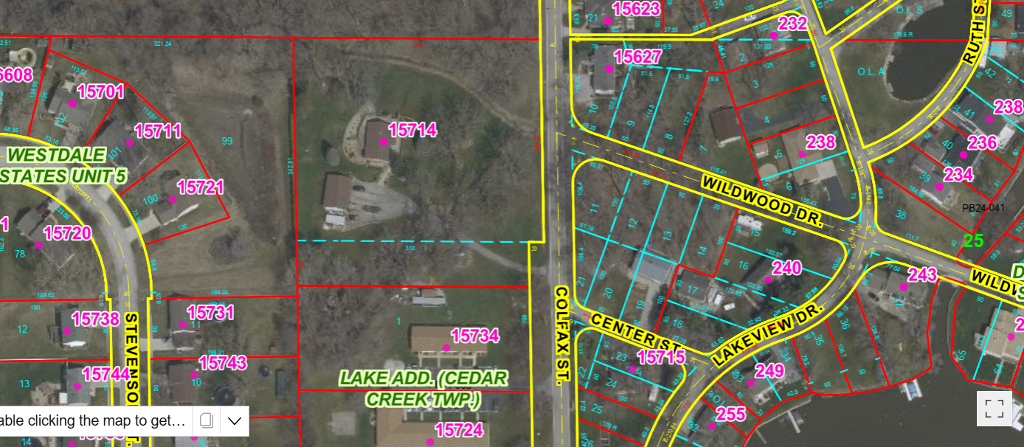
West Dale Estates Stormwater
Flows east under Colfax, within Wildwood Dr Easement, Under Lakeview Dr
Stormwater basin

Slide 4
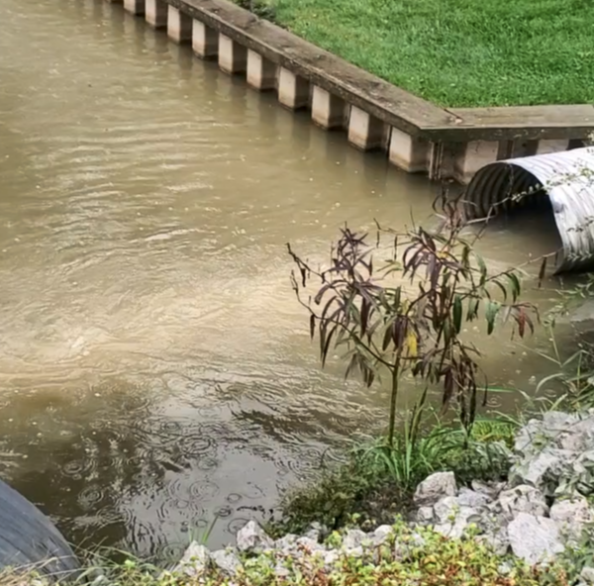

Slide 5
